Slide 1
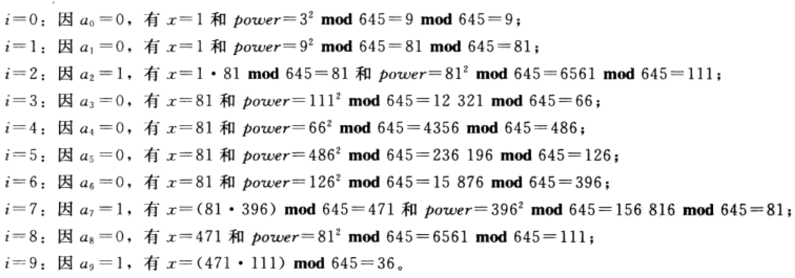
Binary Modular Exponentiation
Find 3²⁰²³ mod 1997
(可不掌握)
Example: Compute 3⁶⁴⁴ mod 645 using this method.
Solution:

Slide 2
Finding Inverses （简单题，可直接试）
The Euclidean algorithm and Bézout coefficients gives us a systematic approaches to finding inverses.
Example: Find an inverse of 3 modulo 7.
Solution: Because gcd(3,7) = 1, by Theorem 1, an inverse of 3 modulo 7 exists.
Using the Euclidian algorithm: 7 = 2∙3 + 1.
From this equation, we get −2∙3 + 1∙7 = 1, and see that −2 and 1 are Bézout coefficients of 3 and 7.
Hence, −2 is an inverse of 3 modulo 7.
Also every integer congruent to −2 modulo 7 is an inverse of 3 modulo 7, i.e., 5, −9, 12, etc.

Slide 3
The Chinese Remainder Theorem （必掌握）
Example: Consider the 3 congruences from Sun-Tsu’s problem:
x ≡ 2 ( mod 3), x ≡ 3 ( mod 5), x ≡ 2 ( mod 7).
Let m = 3∙ 5 ∙ 7 = 105, M₁ = m/3 = 35, M₂ = m/5 = 21, M₃ = m/7 = 15.
We see that
2 is an inverse of M₁ = 35 modulo 3 since 35 ∙ 2 ≡ 2 ∙ 2 ≡ 1 (mod 3)
1 is an inverse of M₂ = 21 modulo 5 since 21 ≡ 1 (mod 5)
1 is an inverse of M₃ = 15 modulo 7 since 15 ≡ 1 (mod 7)
Hence,
x = a₁M₁y₁ + a₂M₂y₂ + a₃M₃y₃
= 2 ∙ 35 ∙ 2 + 3 ∙ 21 ∙ 1 + 2 ∙ 15 ∙ 1 = 233 ≡ 23 (mod 105)
We have shown that 23 is the smallest positive integer that is a simultaneous solution. Check it!

Slide 4
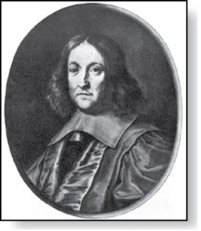
Fermat’s Little Theorem
Pierre de Fermat
(1601-1665)
Theorem 3: (Fermat’s Little Theorem) If p is prime and a is an integer not divisible by p, then a^{p-1} ≡ 1 (mod p)
Furthermore, for every integer a we have a^{p} ≡ a (mod p)
(proof outlined in Exercise 19)
Fermat’s little theorem is useful in computing the remainders modulo p of large powers of integers.
Example: Find 7²²² mod 11.
By Fermat’s little theorem, we know that 7¹⁰ ≡ 1 (mod 11), and so (7¹⁰ )^{k} ≡ 1 (mod 11), for every positive integer k. Therefore,
7²²² = 7^{22∙10 + 2} = (7¹⁰)²²7² ≡ (1)²² ∙49 ≡ 5 (mod 11).
Hence, 7²²² mod 11 = 5.

Slide 5
Discrete Logarithms
Suppose p is prime and r is a primitive root modulo p. If a is an integer between 1 and p −1, that is an element of Z_{p}, there is a unique exponent e such that r^{e} = a in Z_{p}, that is, r^{e} mod p = a.
Definition: Suppose that p is prime, r is a primitive root modulo p, and a is an integer between 1 and p −1, inclusive. If r^{e} mod p = a and 1 ≤ e ≤ p − 1, we say that e is the discrete logarithm of a modulo p to the base r and we write log_{r} a = e (where the prime p is understood).
Example 1: We write log₂ 3 = 8 since the discrete logarithm of 3 modulo 11 to the base 2 is 8 as 2⁸ = 3 modulo 11.
Example 2: We write log₂ 5 = 4 since the discrete logarithm of 5 modulo 11 to the base 2 is 4 as 2⁴ = 5 modulo 11.
There is no known polynomial time algorithm for computing the discrete logarithm of a modulo p to the base r (when given the prime p, a root r modulo p, and a positive integer a ∊Z_{p}). The problem plays a role in cryptography as will be discussed in Section 4.6.
不对称性：
知道p r e 求 a 易
知道p r a 求 e 难

Slide 6
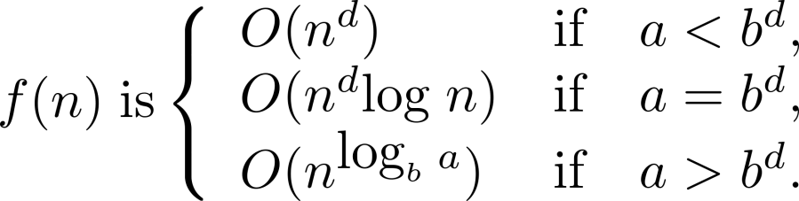
Estimating the Size of Divide-and-conquer Functions (continued)
Theorem 2. Master Theorem:
Let f be an increasing function that satisfies the recurrence relation
f(n) = af(n/b) + cn^{d}
whenever n = b^{k}, where a≥ 1, b is an integer greater than 1, k is a positive integer greater than 1, and c and d are real numbers with c positive and d nonnegative. Then

Slide 7
The number of binary relations that is neither symmetric nor anti-symmetric on A (|A|=n) is _ $2^{n^{2}}−2^{\frac{n\left(n+1\right)}{2}}−3^{\frac{n\left(n−1\right)}{2}}∗2^{n}+2^{n}$_, and the number of equivalent relations (partitions) for A is ___________

Slide 8
Let a permutation have property P_{i} if it fixes element i. 重复的derangement可直接暴力尝试；考的可能性少（screen题）
Theorem: The number of derangements of a set with n elements is
Proof:
The number of derangements is the number of permutations having none of the properties P_{i} for i=1, 2, …, n.
A derangement is a permutation of objects that leaves no object in its original position.

Slide 9
前五题，基础排列组合，及enumeration，二项式系数展开，都是送分题，请完全掌握
〖Example 6〗Find the generating functions for
where n is a positive integer, using the extended Binomial Theorem.
Solution:
By the extended Binomial Theorem , it follows that

Slide 10
5.6 Generating Permutations and Combinations
〖Example 1〗What is the next larger permutation in lexicographic order after 124653?
The next largest permutation of 124653 in lexicographic order is 125346
〖Example 2〗 S_{i} ={2,3,5,6,9,10} is given from the set {1,2,3,4,5,6,7,8,9,10}. Find S_{i+1} .
Solution: S_{i+1} ={2,3,5,7,8,9}

Slide 11
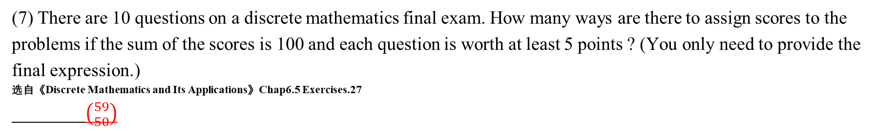
(6) There are 4 kinds of balls colored with Red, Green, Blue and White. The number of each kind is unlimited, and the balls with the same type are unlabeled. How many ways are there to distribute 6 balls into 6 labeled boxes, if there are one or more red balls among them and no box is empty? exp(4,6)-exp(3,6)=3367
(7) There are 10 questions on a discrete mathematics final exam. How many ways are there to assign scores to the problems if the sum of the scores is 100 and each question is worth at least 5 points ? (You only need to provide the final expression.)
选自《Discrete Mathematics and Its Applications》Chap6.5 Exercises.27
$\left({59 \atop 50}\right)$
(8) Consider the strings S = C₁C₂C₃C₄C₅ of length 5 formed by the digits {5,6,7,8}.
In how many of the strings S, the digits are increasing (Cm $≥$ Cn if m > n)? ____56___ (2022-final)

Slide 12
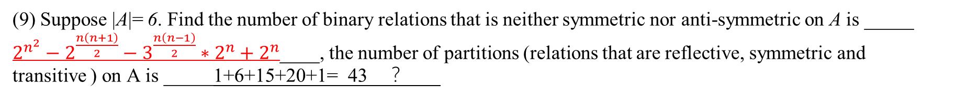
(9) Suppose |A|= 6. Find the number of binary relations that is neither symmetric nor anti-symmetric on A is _____ $2^{n^{2}}−2^{\frac{n\left(n+1\right)}{2}}−3^{\frac{n\left(n−1\right)}{2}}∗2^{n}+2^{n}$____, the number of partitions (relations that are reflective, symmetric and transitive ) on A is _____1+6+15+20+1=_43 __？___
Question:
|A|=3. How many different equivalence relations on the set A are there?
Solution:
an equivalence relation on a set A ↔ a partition of A

Slide 13
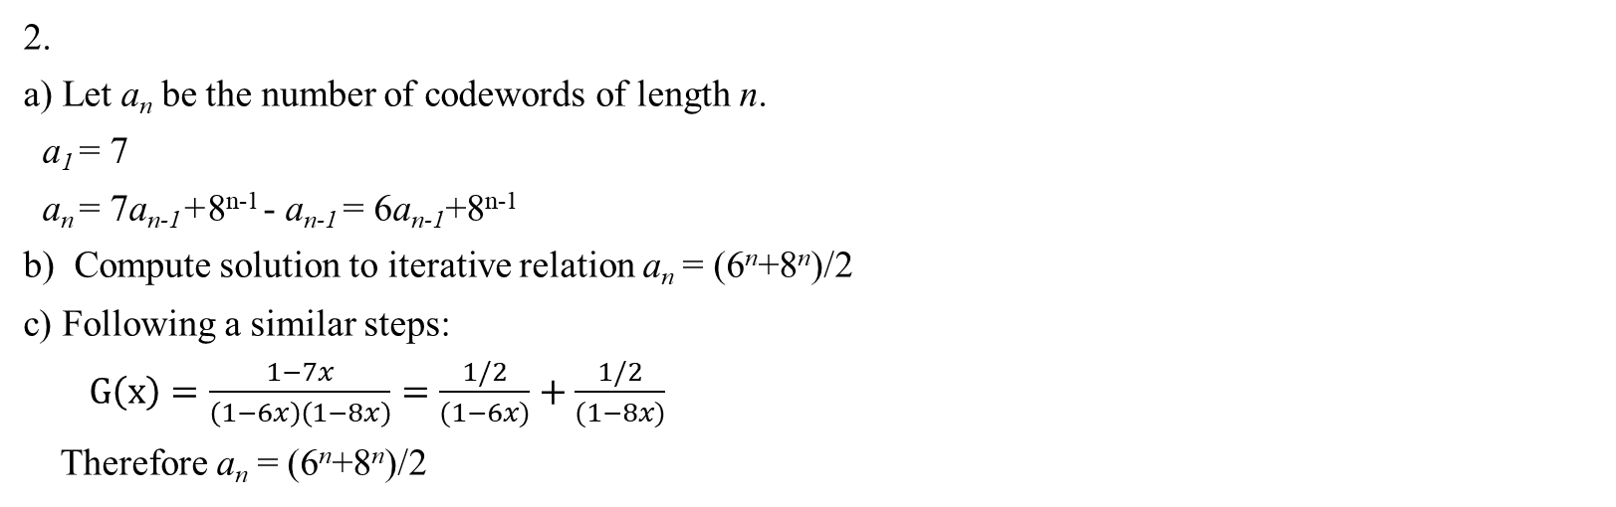
2.
a) Let a_{n} be the number of codewords of length n.
a₁ = 7
a_{n} = 7a_{n-1}+8^{n-1} - a_{n-1} = 6a_{n-1}+8^{n-1}
b) Compute solution to iterative relation a_{n} = (6^{n}+8^{n})/2
c) Following a similar steps:
$G\left(x\right)=\frac{1−7x}{\left(1−6x\right)\left(1−8x\right)}=\frac{1/2}{(1−6x)}+\frac{1/2}{(1−8x)}$
Therefore a_{n} = (6^{n}+8^{n})/2

Slide 14
3. (10 %) Let S= {x∈N｜1≤x≤2022}. How many numbers at most can be selected from S to make up a subset T⊆ S, such that for any two different numbers x,y∈ T, their sum is not divisible by their difference. Give the reason.
Solution
674 = 2022/3
抽屉：{1,2,3}{4,5,6}…{3k+1,3k+2,3k+3}…{2020,2021,2022}
取1,4,…,2020,每两数和除3余2，差为3倍数，所以满足条件。
若超674个，则一定有两个落入同一抽屉，同一抽屉若差1，不满足；若差2，同奇偶，和为偶数，不满足。

Slide 15
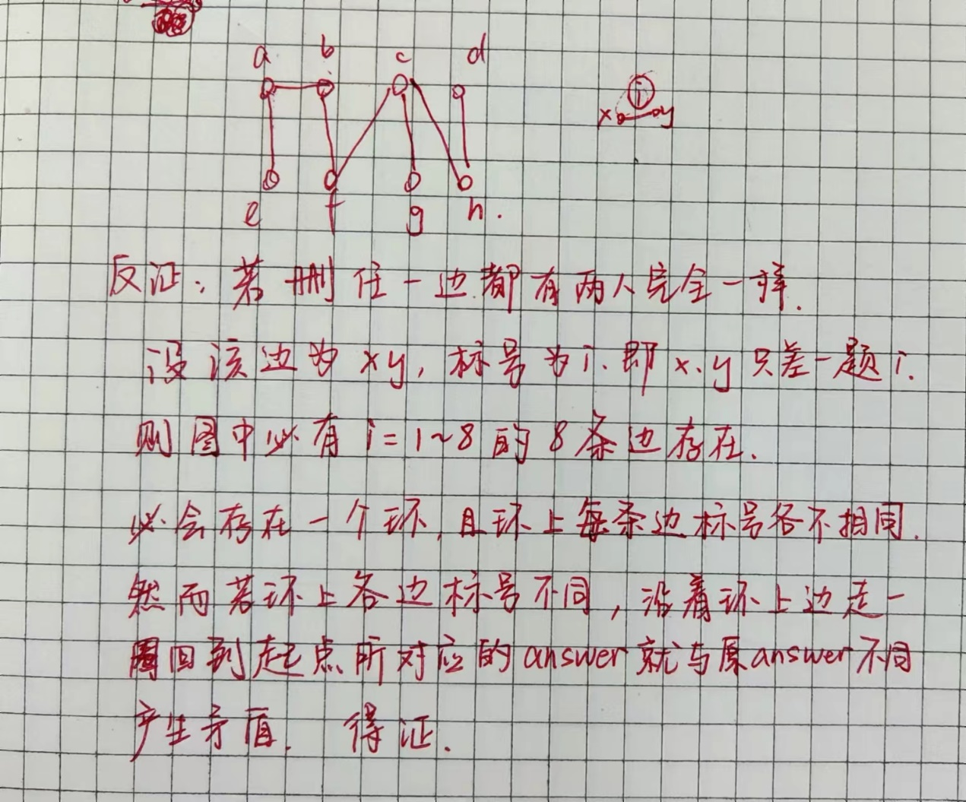
Quiz 3
5. r=1, or s=1
6. 15
8. 15
10.
1） 80
2） 2
3） 有
11. 8 students take a test with 8 true/false questions. It is known that no two students make exactly the same choice. Prove that we can remove one of the 8 questions, and still no two students make exactly the same choice.

